Slide 1
The Evolution of European Unity

Slide 2
Political cooperation The council of Europe, 1949
The Hague, 1949: 750 delegates from 16 European countries met for the Congress of Europe.
They agreed that: 1.) there should be cooperation in political and economic issues
2.) there should be an assembly to discuss issues between the states
3.) a Court of Human Rights
Then, the COUNCIL OF EUROPE was established in Strasbourg in 1949, with 10 members initially. It created the European Convention on Human Rights and established the Court of Human Rights (ECHR)

Slide 3
The Council of Europe
Remember!
The federalist ideas eventually led to the creation of the Council of Europe. Set up in 1949, it had little power but it promoted the idea of European integration. It met in the city of Strasbourg, on the border of France and Germany, so that it would not be associated with any capital city. It set up a Court of Human Rights, a successful body that continues to adjudicate today.
Not a supranational body but a forum for dialogue and cooperation
Laid groundwork for deeper integration efforts
https://www.youtube.com/watch?v=rl3gtHtJrL4

Slide 4
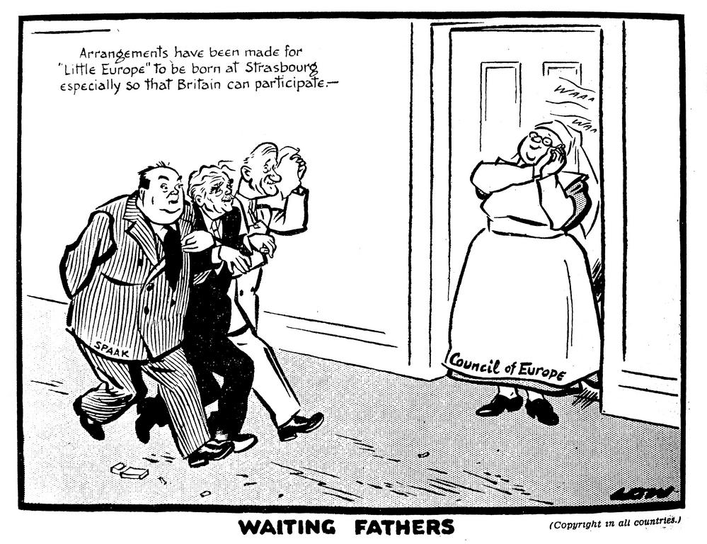

Slide 5
Economic Cooperation
Benelux Treaty, 1947
Before the end of the war, Belgium, the Netherlands and Luxembourg agreed to abolish all customs duties benefits of free trade and economic cooperation

Slide 6
Organization for European Economic Cooperation (OEEC)
Established as part of the Marshall Plan
Foundation: Established on April 16, 1948, in Paris by 16 European countries (with West Germany and Trieste joining later in 1949) to coordinate the European Recovery Program (ERP).
Purpose: To efficiently distribute nearly $13 billion in U.S. aid (approximately $130 billion in today’s value) to stimulate production, stabilize currencies, and promote multilateral trade.
Operations: The OEEC required member countries to cooperate economically, removing trade barriers and facilitating the reconstruction of infrastructure.
Results: The plan spurred the rapid economic recovery of Western Europe, helping to curb Soviet influence during the Cold War.

Slide 7
Organisation for European Economic Co-operation
Remember!
The Organisation for European Economic Co-operation (OEEC) came into being on 16 April 1948. It emerged from the Marshall Plan and the Conference of Sixteen (Conference for European Economic Co-operation), which sought to establish a permanent organisation to continue work on a joint recovery programme and in particular to supervise the distribution of aid. The headquarters of the Organisation was in the Chateau de la Muette in Paris, France.
The European organisation adopted was a permanent organisation for economic co-operation, functioning in accordance with the following principles:
promote co-operation between participating countries and their national production programmes for the reconstruction of Europe,
develop intra-European trade by reducing tariffs and other barriers to the expansion of trade,
study the feasibility of creating a customs union or free trade area,
study multi-lateralisation of payments, and
achieve conditions for better utilisation of labour.

Slide 8
European Coal and Steel Community (ECSC), 1952
By 1950, the problem of West Germany had to be addressed. Reconstruction was under way and the French feared that it would once again threaten other states. So,
The French government launched the Schuman Plan in 1950
Schuman proposed that “Franco-German production of coal and steel as a whole be placed under a common High Authority, within the framework of an organization open to the participation of the other countries of Europe”.
The Schuman Plan led to the Paris Treaty, 1951. War now was “not only unthinkable but materially impossible”. Six states joined: France, West Germany, Italy, Belgium, the Netherlands and Luxembourg. * 9th of May (when Schuman launched the plan in 1950) today celebrated as Europe Day
In short: the Schuman Plan turned former enemies into economic partners to prevent another European war.

Slide 9
Importance of the ECSC
The first time states handed over some of their power to an external body
The model (High Authority, Council of Ministers and Parliamentary Assembly) would be the basis for the structure of the future EEC and EU
It was hugely successful: steel production increased, industrial production grew at twice the rate of Britain’s
Britain decided not to join – they didn’t want to give away part of their sovereignty and didn’t believe the Community would work.
By late 50s it seemed natural to extend the principle of the ECSC to other economic areas.

Slide 10
Military Cooperation
NATO, 1949
In 1948m the Treaty of Brussels was signed by France, Britain and the Benelux countries. It was a mutual defence commitment. After the Berlin Blockade, the US committed to European defence and the Brussels pact was expanded to NATO in 1949. It comprised the USA, Canada and 19 Western European States.
Transfer of sovereignty again!

Slide 11
The nato
Remember!
As a response to sovietisation
1949: USA, Canada and other western European states set up the North Atlantic Treaty Organisation (Nato) – a military alliance according to which: the member states would “come to each other’s aid if one of them were attacked”
NATO (1949-):https://www.youtube.com/watch?v=8MQ59Ij5fkM

Slide 12
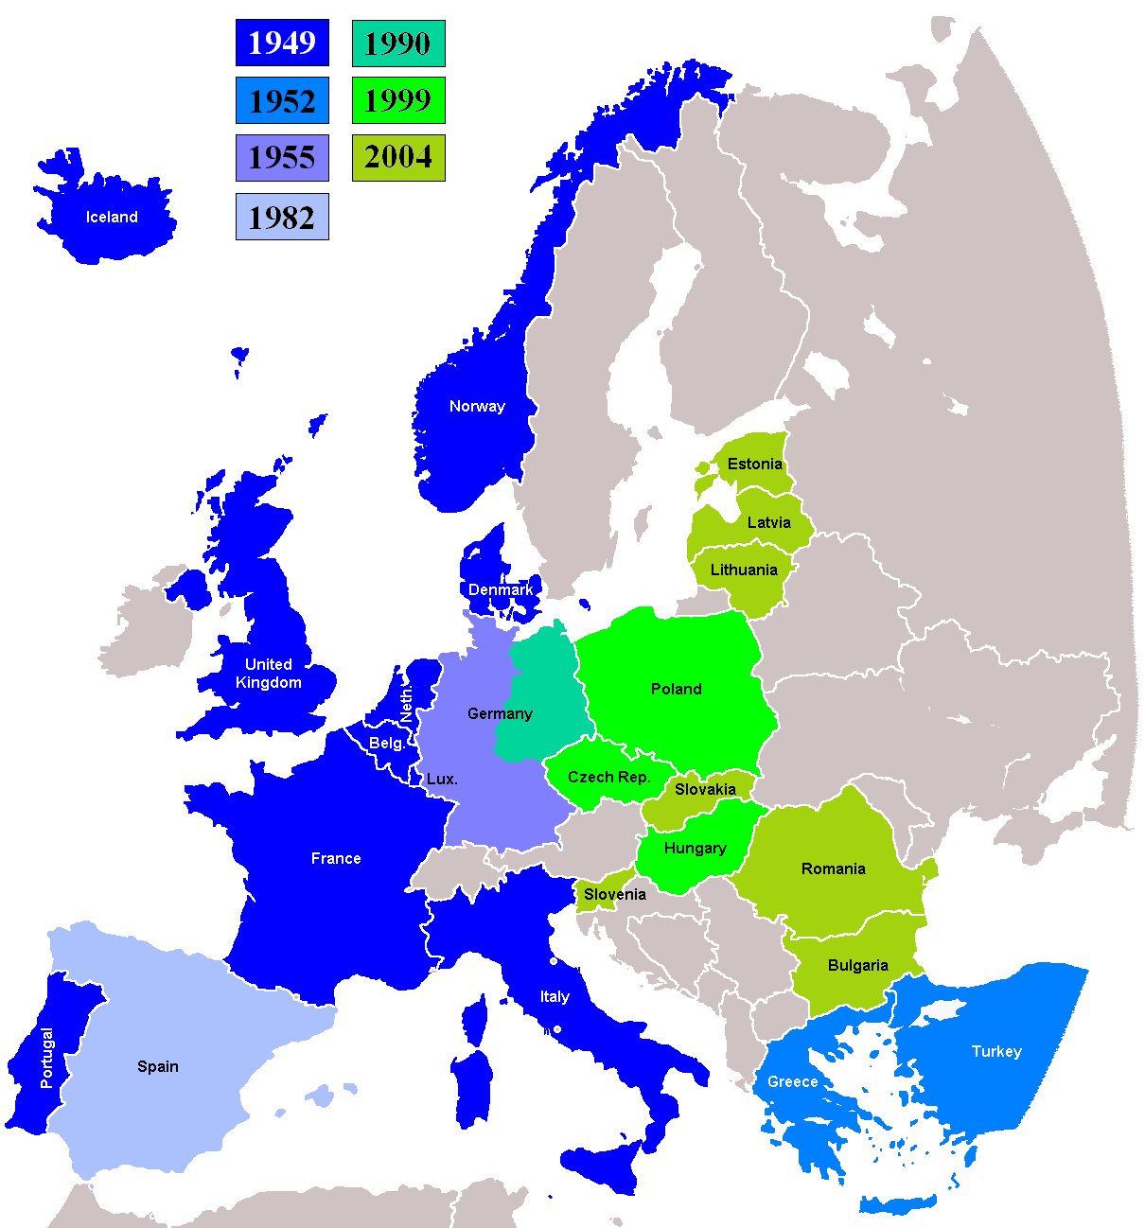
Remember!

Slide 13
European defence community, (EDC), 1952
During the Korean War (early 50s) the USA put pressure on Europe to assume responsibility for its own defence and especially for the re-arming of West Germany.
The French government proposed that re-arming could be allowed within a European Defence Community. This could control the German army and create a joined command structure.
The EDC treaty was signed by the six members of the ECSC in 1952. BUT: opposition in France: 1. over the loss of sovereignty and increasing Cold War tensions (from French communists) the plan was rejected by the French Parliament in 1954. The first setback. So, from then on they would refocus on economics as the method for integration.

Slide 14
In Detail: Monnet’s Failure: The campaign for a single European army
The European Defence Community (EDC) was a plan proposed in 1950 by René Pleven in response to the American call for the rearmament of West Germany. The intention was to form a pan-European defence force as an alternative to Germany's proposed accession to NATO. The EDC was to include West Germany, France, Italy, and the Benelux countries. A treaty was signed on 27 May 1952, but the plan never went into effect. The plan collapsed when it failed to obtain ratification in the French Parliament. There were Gaullist fears that the EDC threatened France's national sovereignty and fears about Germany's remilitarization.

Slide 15
Communists opposed any plan tying France to the capitalist USA and setting it in opposition to the Communist bloc. Other legislators worried about the absence of the United Kingdom. The EDC went for ratification in the French National Assembly on 30 August 1954, and failed by a vote of 264-319. By this time, concerns about a future conflict faded with the death of Joseph Stalin and the end of the Korean War. The EDC would have established a pan-European military, divided into national components. In this military, the French, Italian, Belgium, Dutch and Luxembourg components would report to their national governments, whereas the German component would report to the EDC. However, in the event of its rejection, it was agreed to let the German government control its own military.

Slide 16
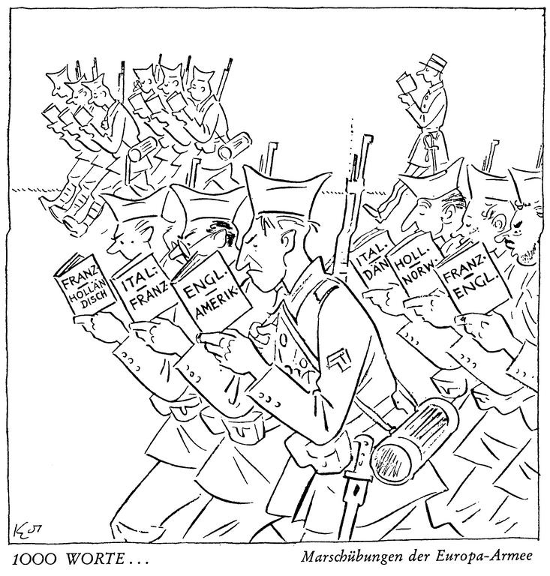
What is the message of the following cartoons?
Are they for or against the creation of the EDC?

Slide 17
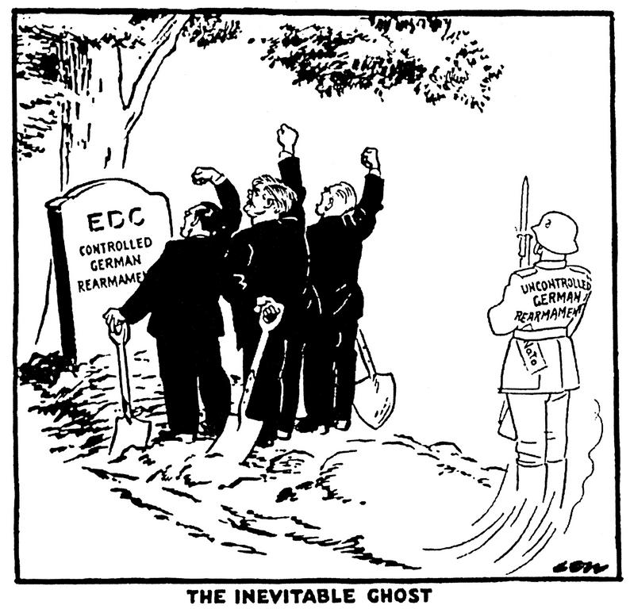

Slide 18
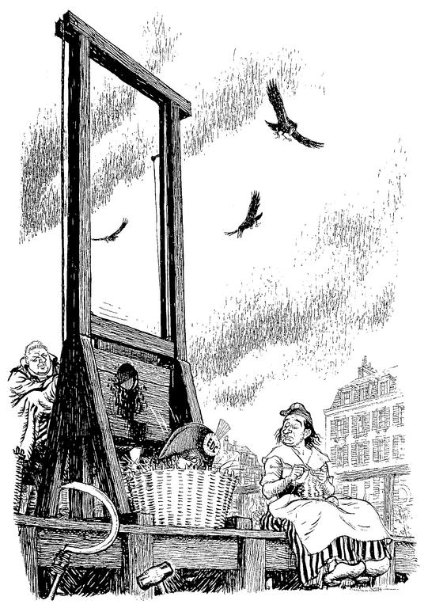

Slide 19
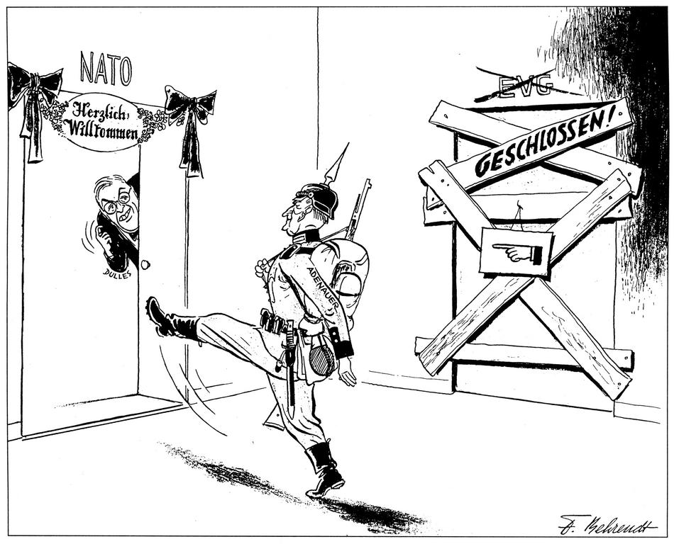

Slide 20
